Slide 1

Unit II : Trees
Dipti Jain

Slide 2

The word “tree” suggest branching out from a root and never completing a cycle.

Slide 3

Let’s create a Graph
Consider a group of boxers contending for the title of heavyweight champion of the world. Suppose that each boxer has one chance to challenge the reigning champion and the loser of any match will be eliminated from contention.
Let G(V,E) be an undirected graph where vertices in V represent the boxers and the edges E represent these matches. Let V={ a,b,c,d,e,f,g,h,i} . Following are the results –
a is the reigning champion in the beginning
a beat b,c and d and then a loses title to e
e beats f,g and then loses tite to h
h loses title to i

Slide 4

f
b
a
e
g
i
c
d
h

Slide 5
Trees and Forests
Acyclic Graph
A graph with no cycle is acyclic
Forest
A forest is an acyclic graph
Tree
A connected acyclic graph

Slide 6
Degenerate Tree:
A tree with a single vertex is called a degenerate tree.
Leaf:
In an undirected tree, a leaf (also called a pendant vertex) is a vertex
of degree 1.

Slide 7
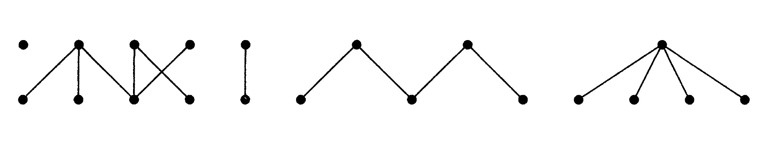

Slide 8
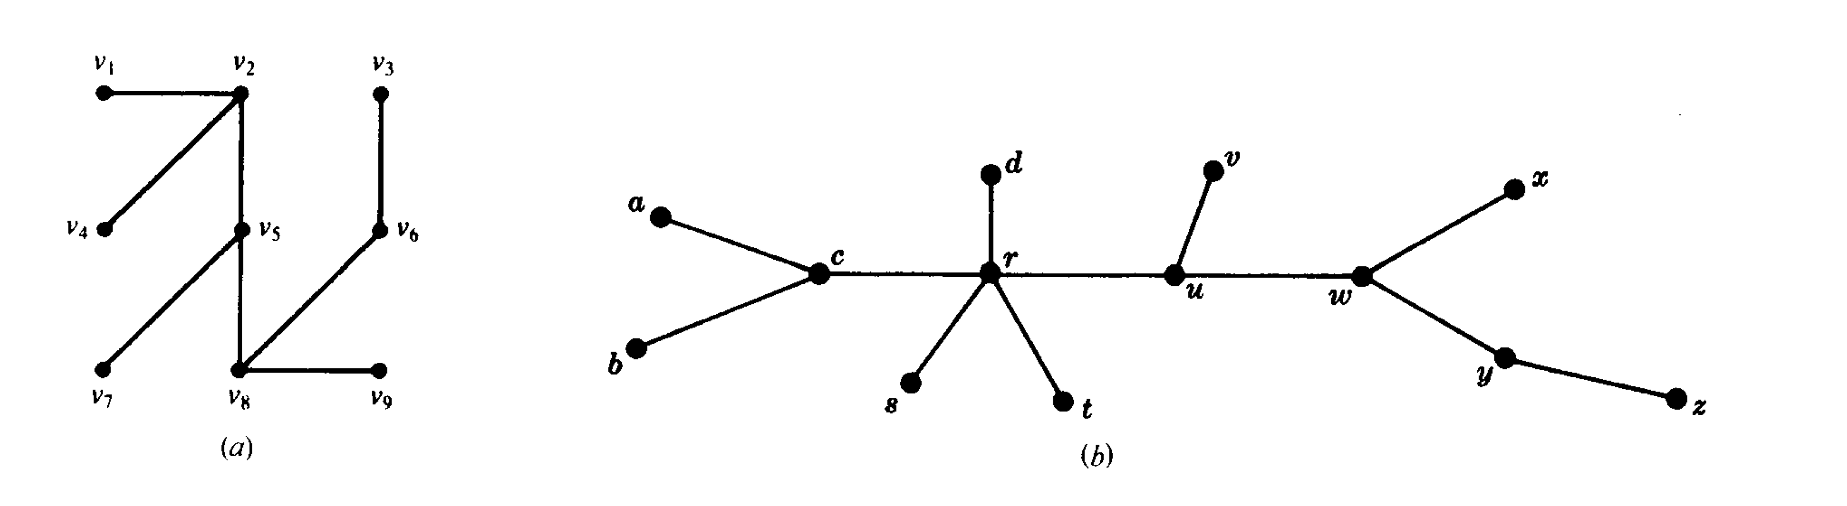

Slide 9
Characterizations of Trees
Theorem:
If T is a graph with n vertices, the following are equivalent:
T is a tree
T contains no cycle and n-1 edges
T is connected and has n-1 edges
T is connected and every edge is a cut-edge
Any two vertices of T are connected by exactly one path
T contains no cycle and for any new edge ‘e’ , T+ e has exactly
one cycle

Slide 10

Proof

Slide 11
Spanning Tree
Spanning Tree:
A subgraph T of a connected graph G is called a spanning tree of G if T is a tree and T includes all the
vertices of G.
Weighted Graph:
A graph G is called a weighted graph if each edge e of G is assigned a non- negative number w(e) called the weight (or length) of v.

Slide 12
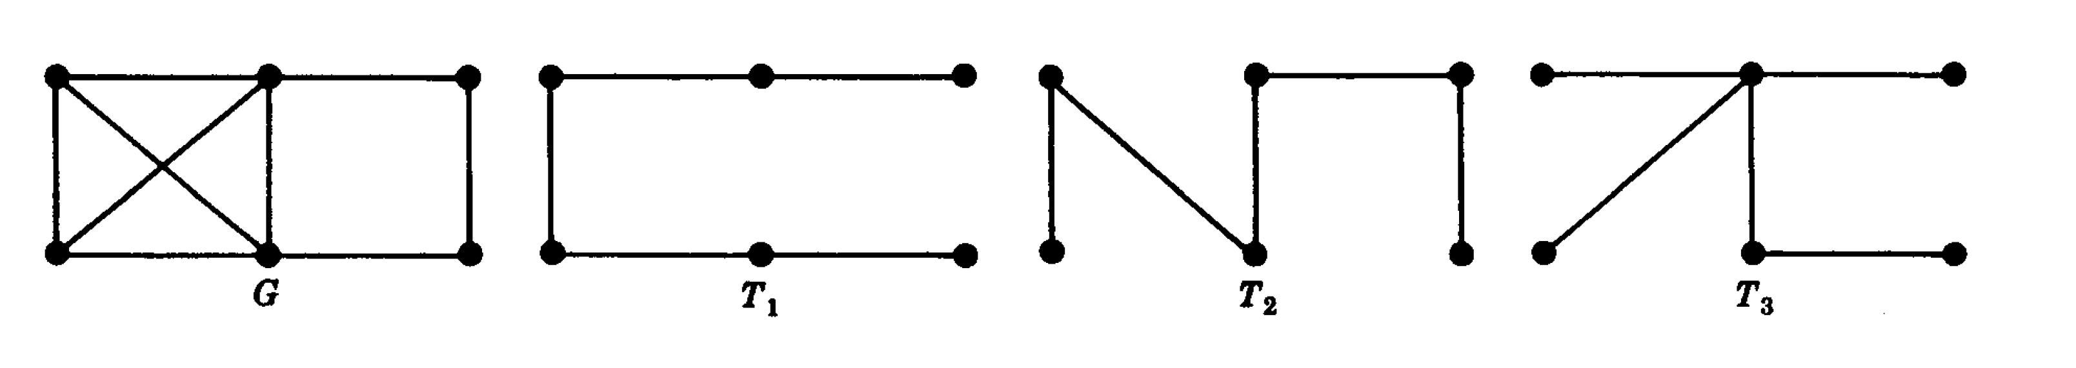

Slide 13
Minimum Spanning Tree
Minimum Spanning Tree:
A Minimum Spanning Tree(MST) or minimum weight spanning tree for a weighted, connected, undirected graph is a spanning tree having a weight less than or equal to the weight of every other possible spanning tree.

Slide 14
Kruskal’s Algorithm
Minimum Spanning Tree:
Kruskal’s algorithm sorts all the edges in increasing order of their edge weights and keeps adding nodes to the tree only if the chosen edge does not form any cycle. Also, it picks the edge with a minimum cost at first and the edge with a maximum cost at last. Hence, you can say that the Kruskal algorithm makes a locally optimal choice, intending to find the global optimal solution. That is why it is called a Greedy Algorithm.

Slide 15
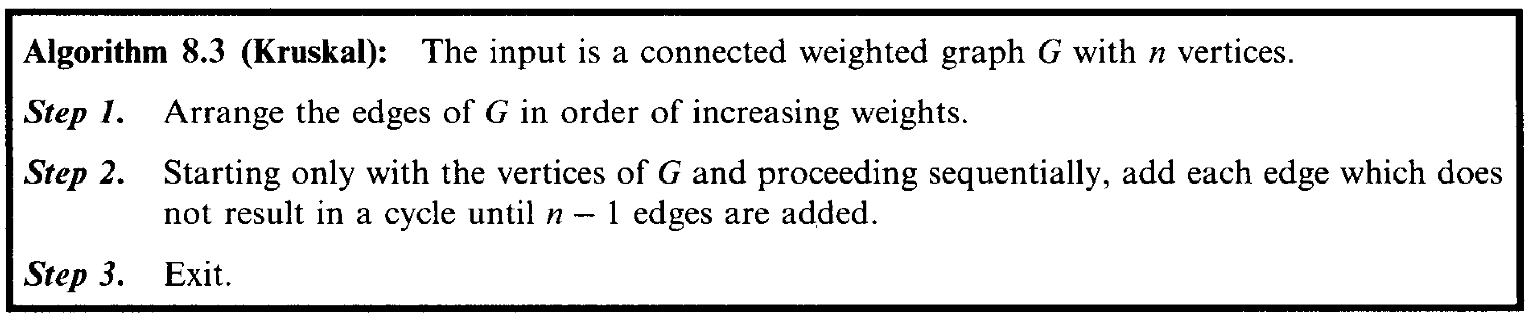

Slide 16
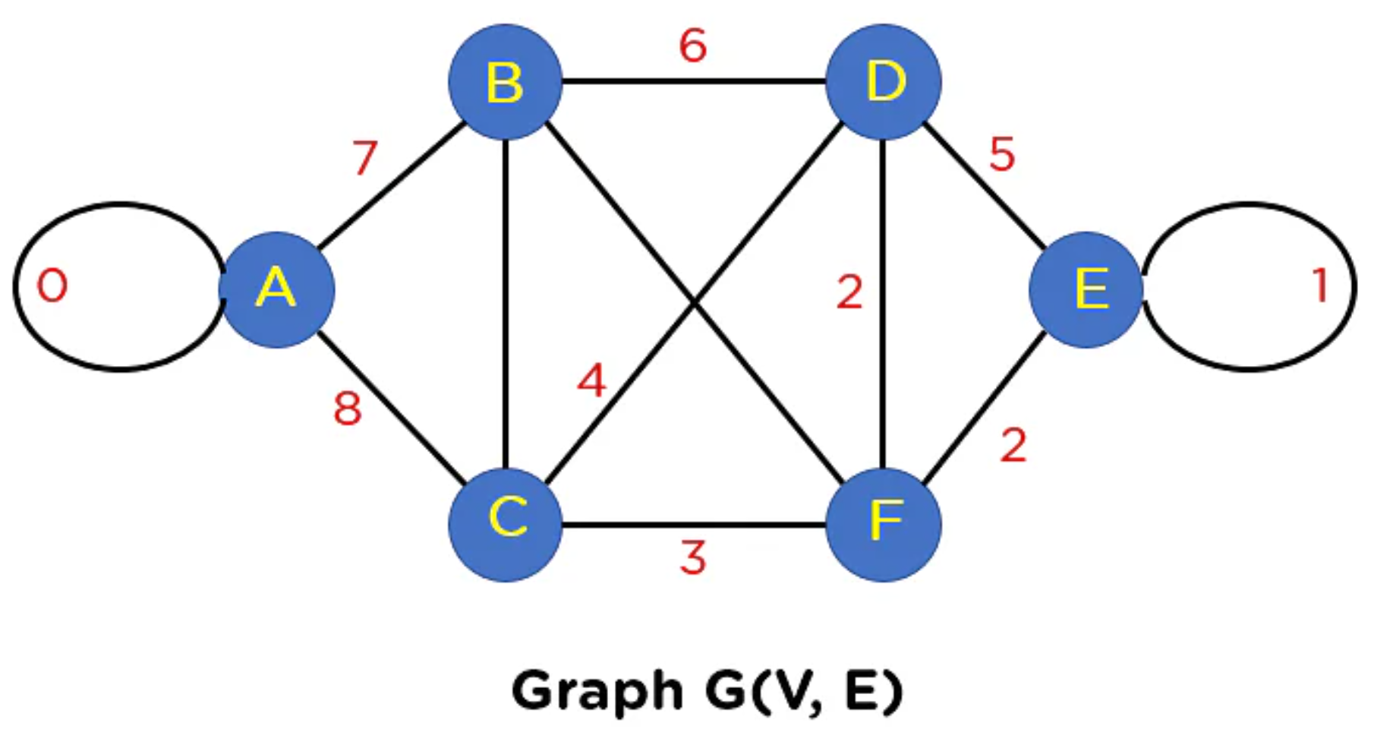

Slide 17
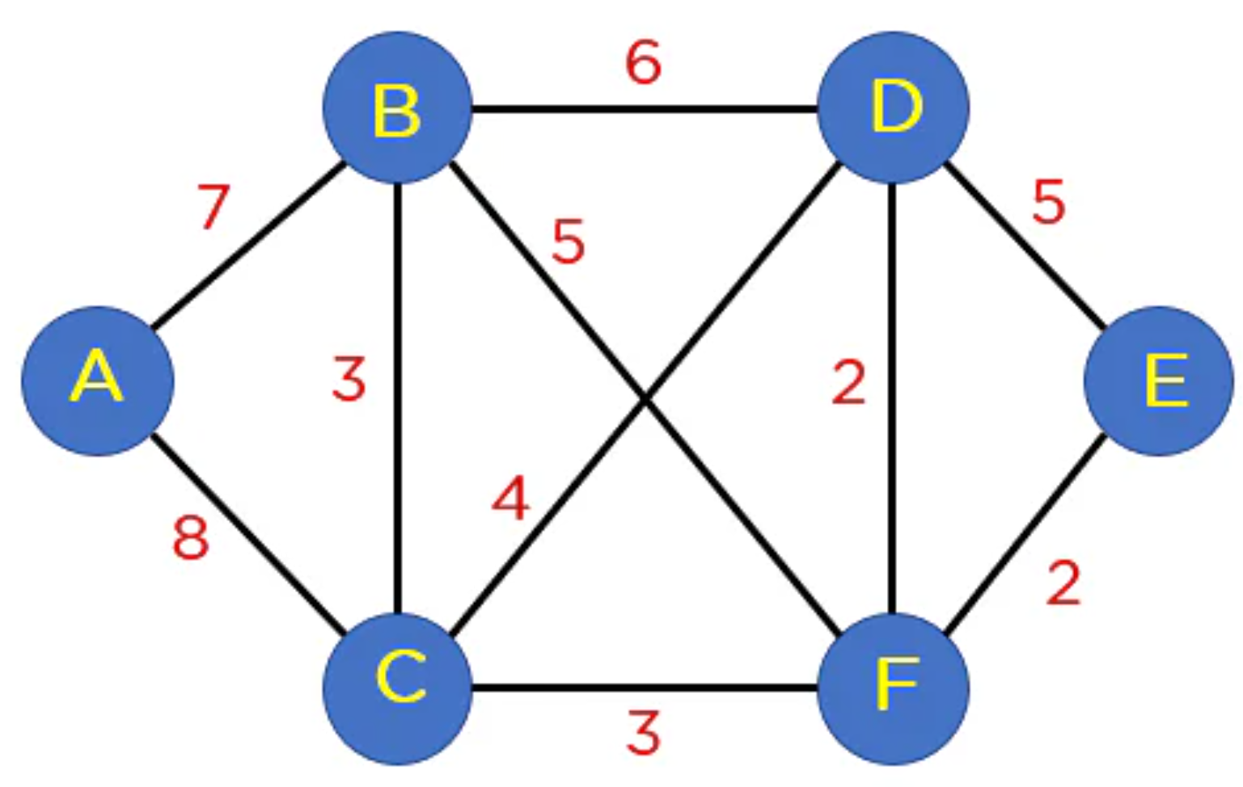

Slide 18
Edge | EF | FD | BC | CF | CD | BF | BD | AB | AC
Weight | 2 | 2 | 3 | 3 | 4 | 5 | 6 | 7 | 8

Slide 19
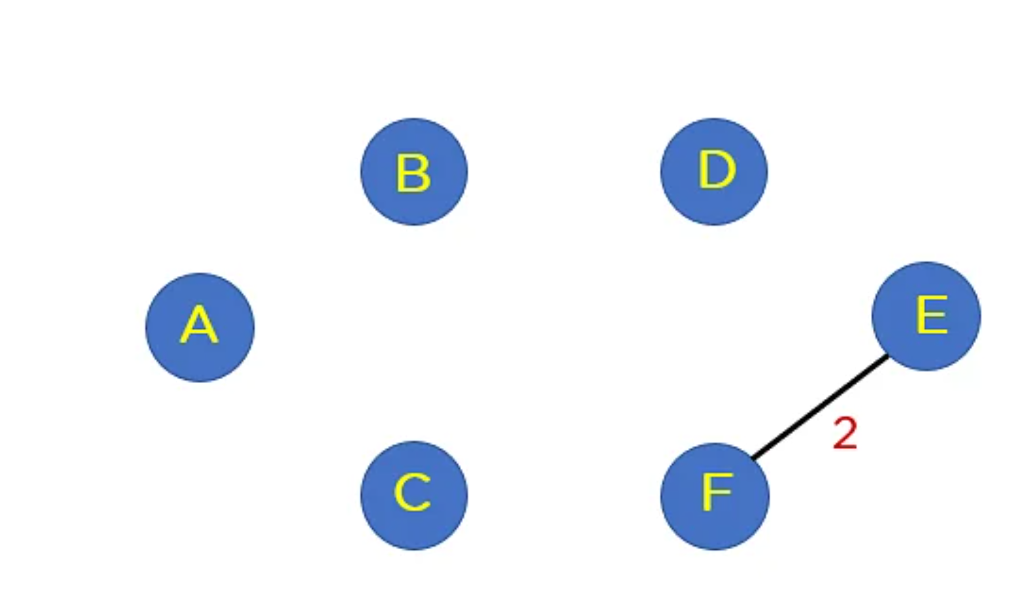
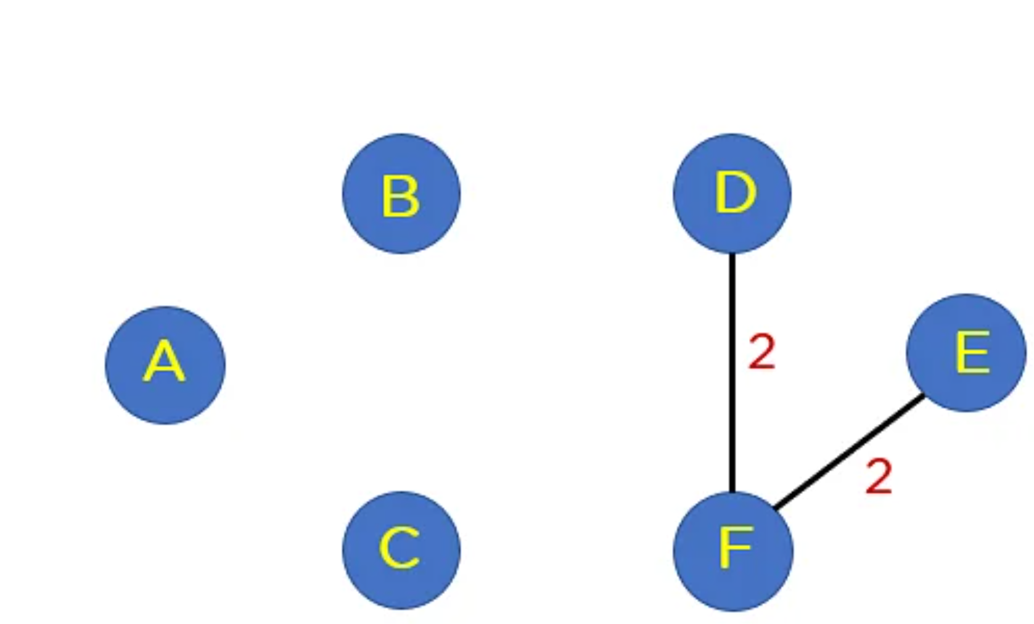
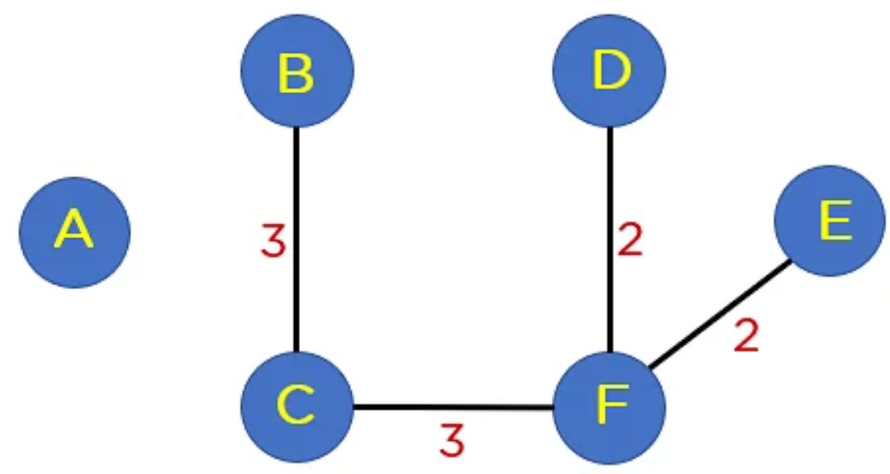
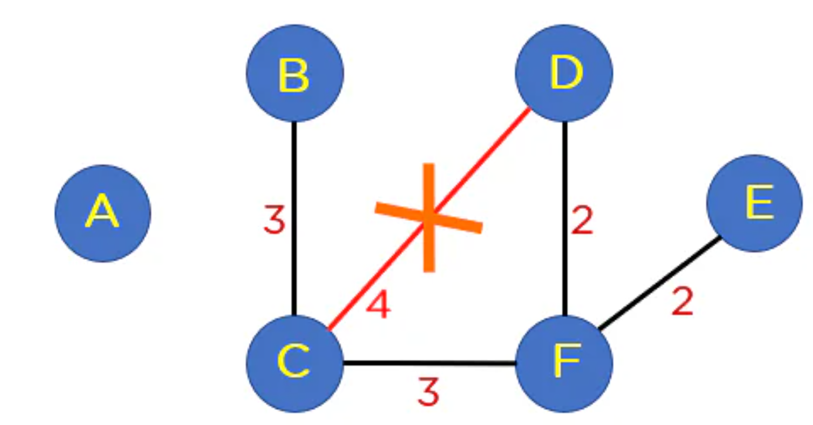

Slide 20
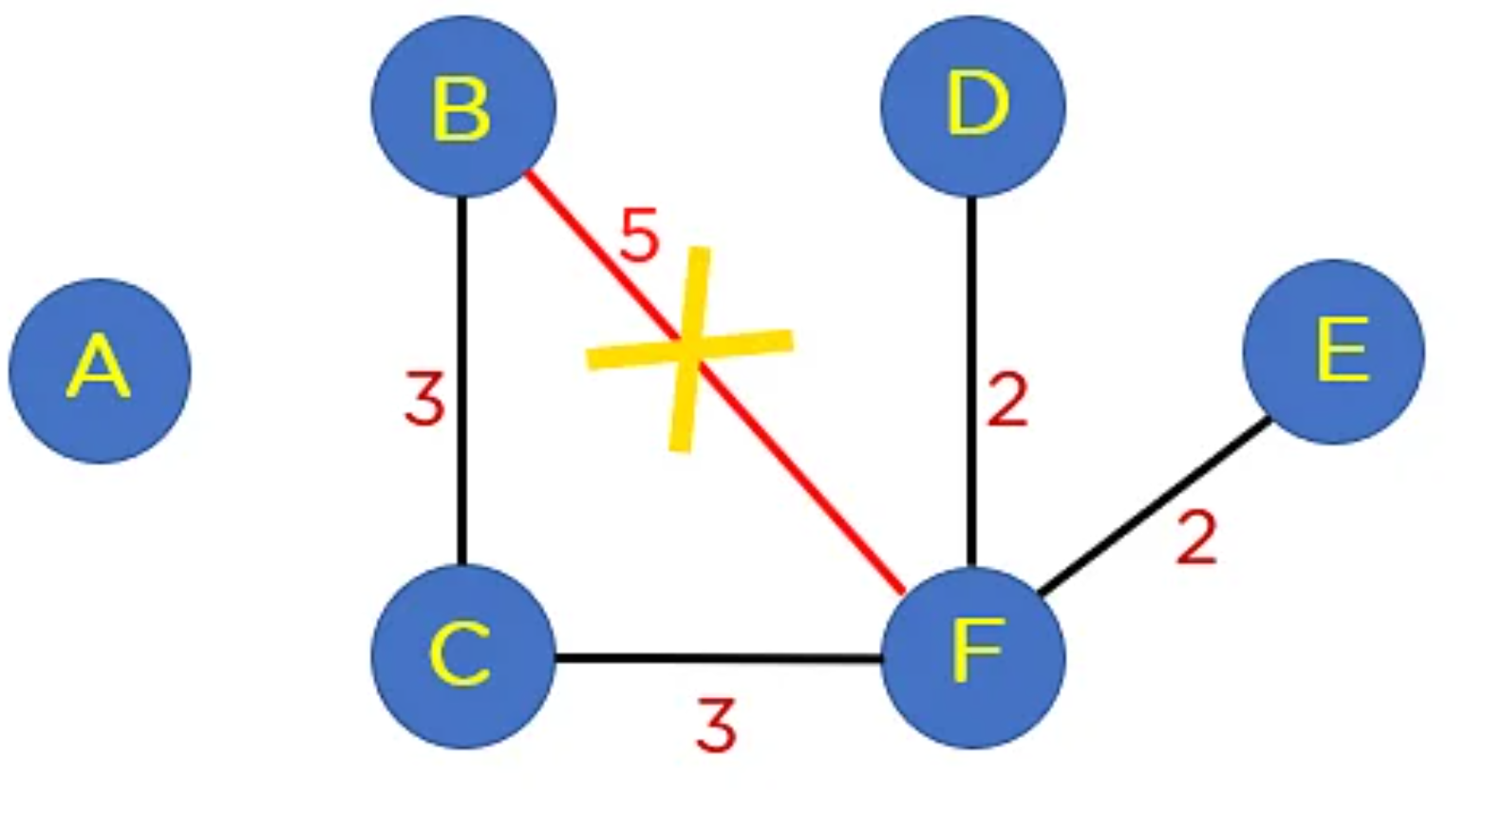
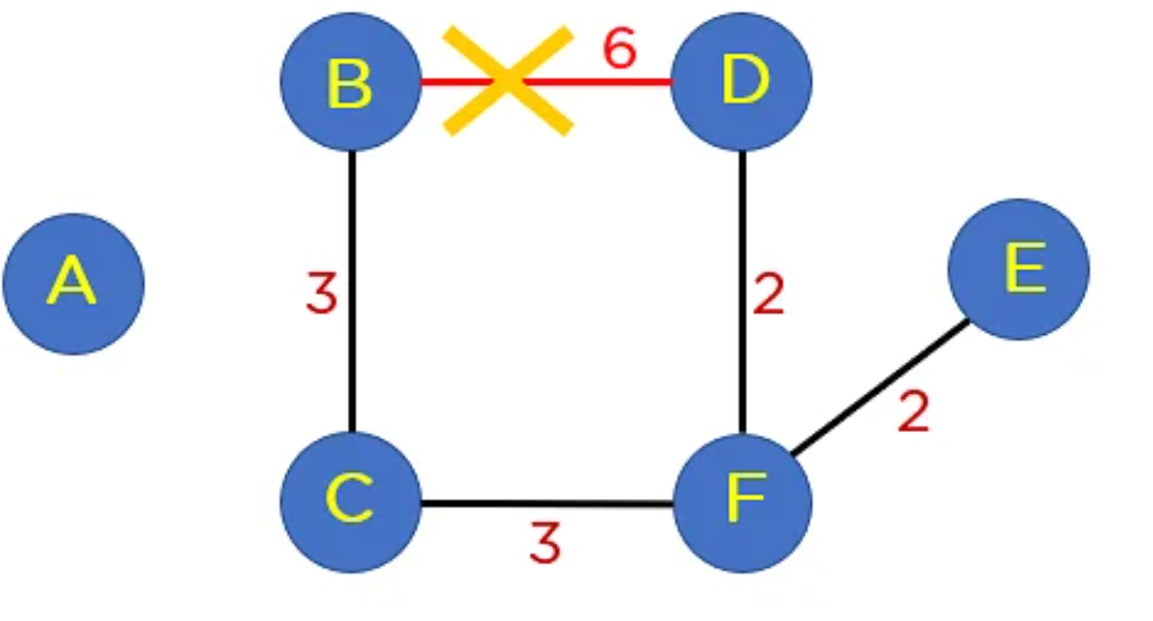
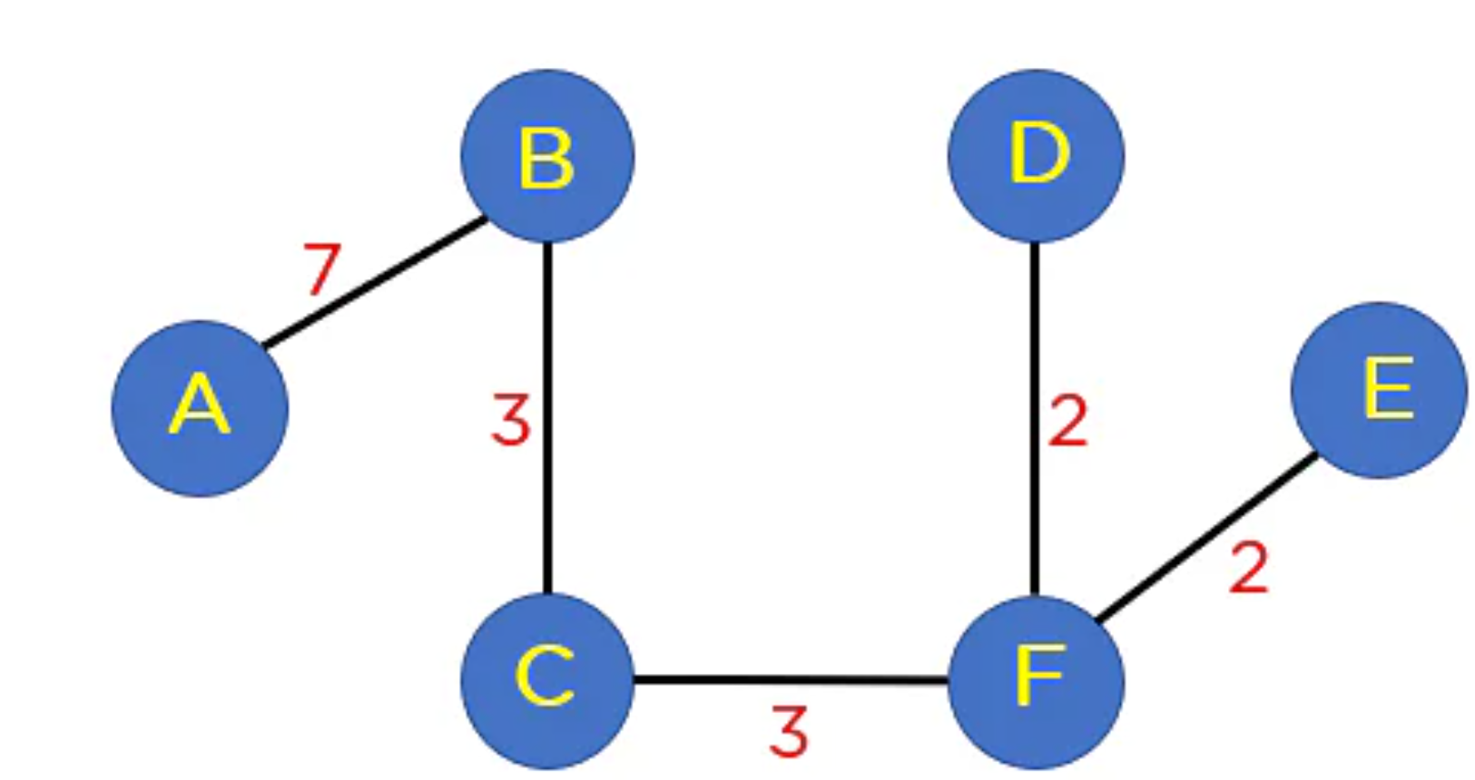

Slide 21
Properties of Minimum Spanning Tree
Multiplicity:
If there are n vertices in the graph, then each spanning tree has n − 1 edges. There may be several minimum spanning trees of the same weight; in particular, if all the edge weights of a given graph are the same, then every spanning tree of that graph is minimum.
Uniqueness:
If each edge has a distinct weight then there will be only one, unique minimum spanning tree.

Slide 22
Minimum-Cost subgraph:
If the weights are positive, then a minimum spanning tree is in fact a minimum-cost subgraph connecting all vertices, since subgraphs containing cycles necessarily have more total weight.
Cycle Property:
For any cycle C in the graph, if the weight of an edge e of C is larger than the individual weights of all other edges of C, then this edge cannot belong to an MST.

Slide 23
Cut Property:
For any cut C of the graph, if the weight of an edge e in the cut-set of C is strictly smaller than the weights of all other edges of the cut-set of C, then this edge belongs to all MSTs of the graph.
Minimum cost edge:
If the minimum cost edge e of a graph is unique, then this edge is included in any MST.

Slide 24
Contraction:
If T is a tree of MST edges, then we can contract T into a single vertex while maintaining the invariant that the MST of the contracted graph plus T gives the MST for the graph before contraction

Slide 25
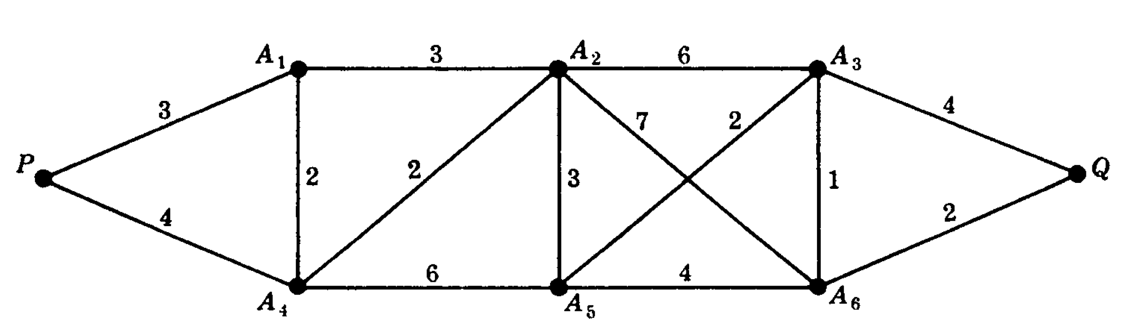

Slide 26
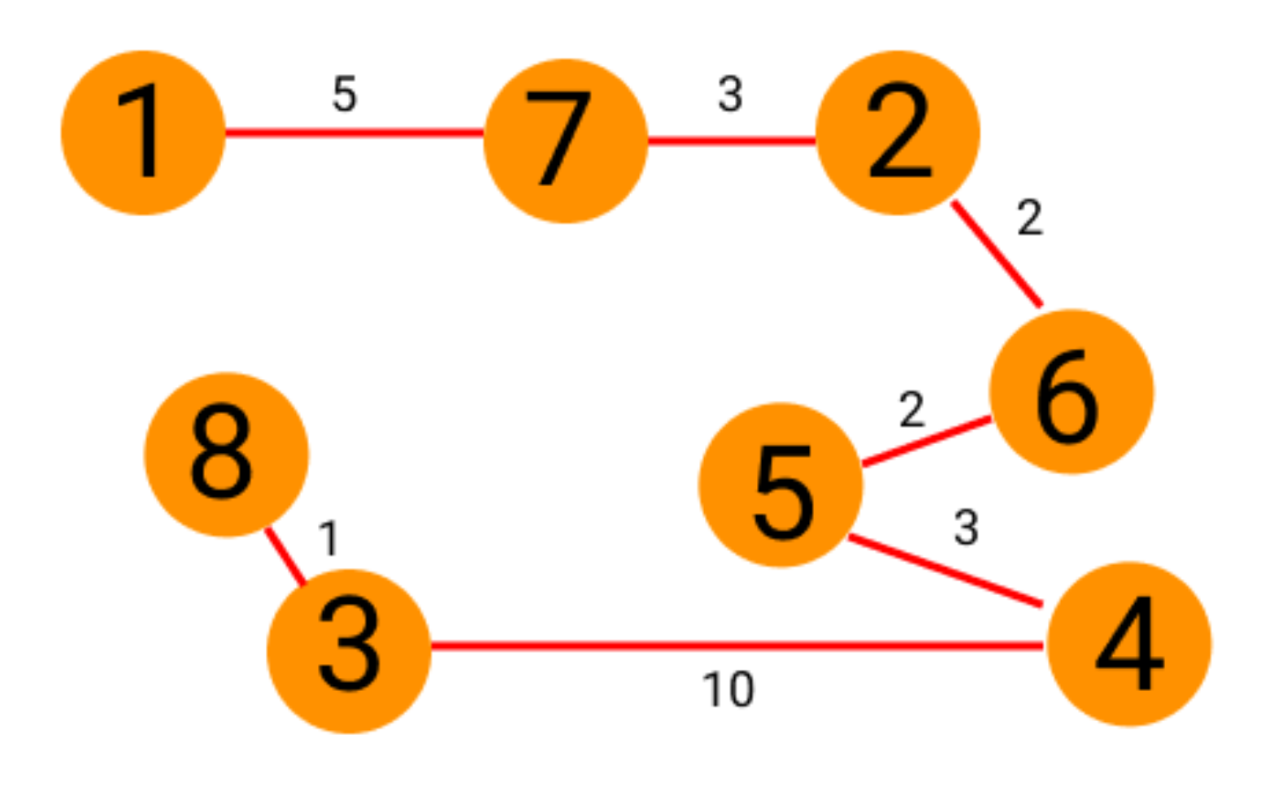
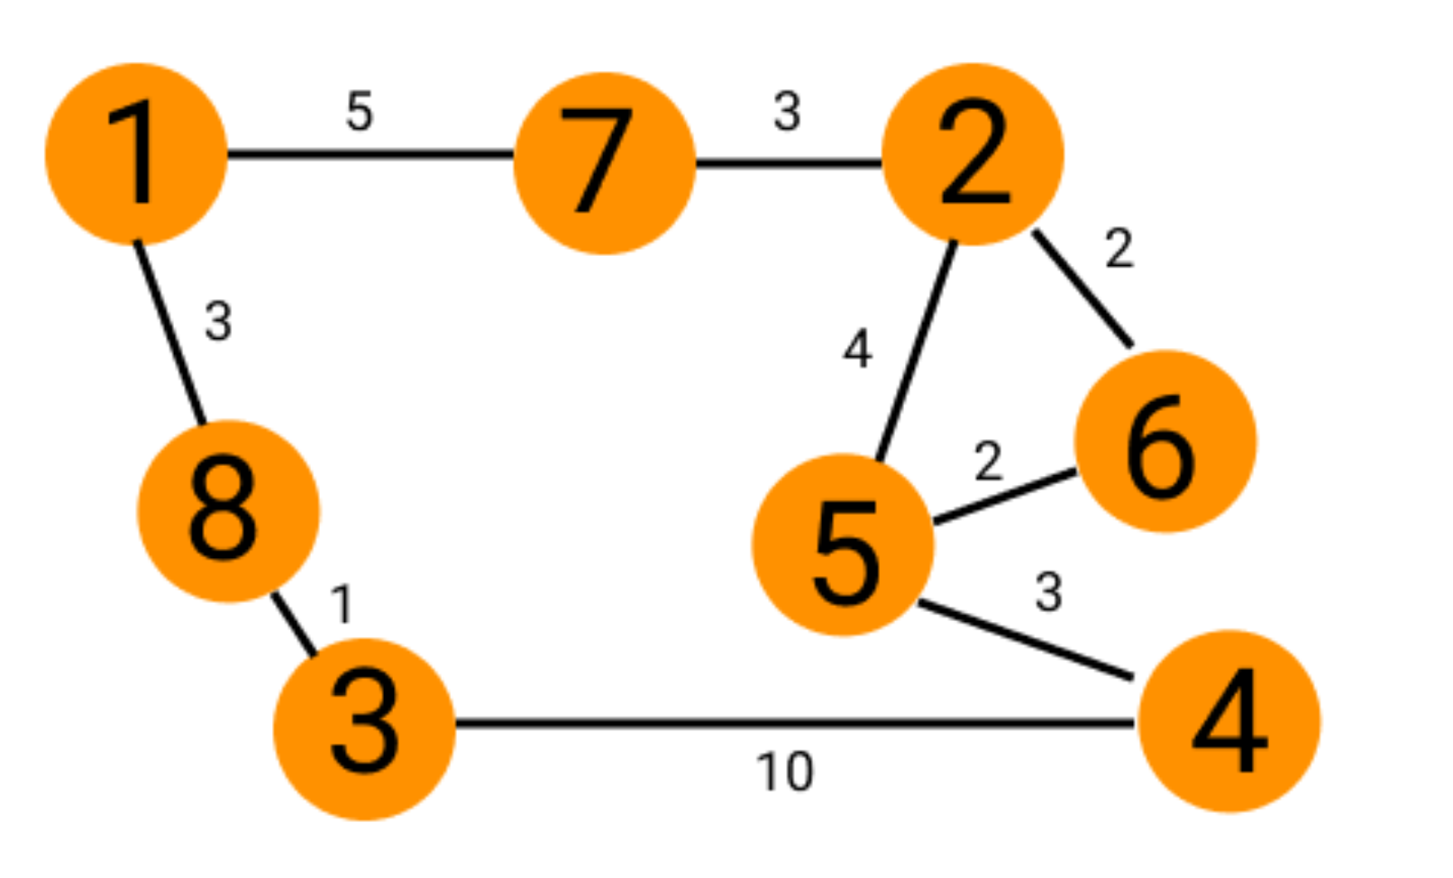

Slide 27
